Slide 1
An Approximation approach for Multiple Sequence Alignment Using Central Star Method with
DNA Sequence Datasets
Gudipati Sai Krishna(M190241CS)
Nandi Dileep Kumar(M190437CS)

Slide 2
Contents
Introduction
Problem Definition
Literature Survey
Proposed Method
Implementation
Results
Conclusion
References

Slide 3
Introduction
Sequence Alignment:
Arranging sequences of DNA,RNA or protein to identify regions of similarity.
The similarity may indicate the functional.structural and evolutionary significance of the sequence.
Sequence Alignment
Pairwise sequence alignment Multiple sequence alignment

Slide 4
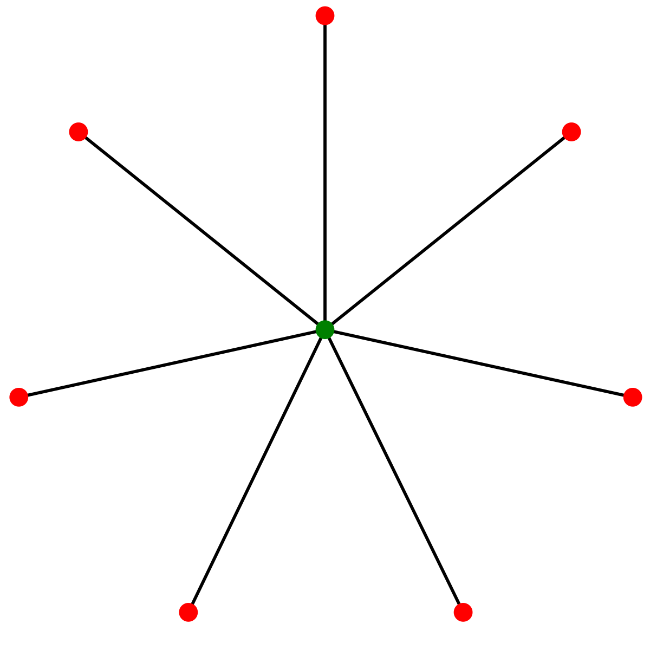
Central Star Method
It is an approximation solution for aligning multiple sequences.
it uses heuristic methods rather than global optimization because identifying the optimal alignment between more than a few sequences of moderate length is computationally expensive and consumes more time.

Slide 5
Problem Definition
Problem Statement: Find a multiple sequence alignment of S that maximizes a similarity function or minimize a distance function.
Input: A set S of sequences.
Output: A new set of sequences of equal length formed after multiple sequence alignment

Slide 6
Literature Survey
Performing an MSA on a given set of DNA sequence and extracting maximum information from the alignment comprises a number of prominent steps:
The selection of sequences.
The choice of the scoring function used to compare sequences or sequence blocks.
The application and optimization of this scoring function in compiling the alignment.

Slide 7
Literature Survey
Needleman-Wunsch algorithm:
it is used to align protein or nucleotide sequences.
It was one of the first applications of dynamic programming to compare biological sequences.
The algorithm assigns a score to every possible alignment, and the purpose of the algorithm is to find all possible alignments having the highest score.It produces pairwise aligned sequences after calculating penalties and inserting gaps.

Slide 8
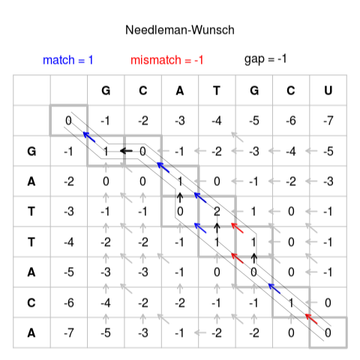
Example
Formula:
Scoring System:
Match: 1
Mismatch: -1
Gap: -1

Slide 9
Proposed Method
Given a family {S1,S2,....Sk} of k sequences, such that the sequences are similar to each other, we would like to find out the common characteristics of this family.
A multiple alignment is a new set of sequences {S’1 ,S’2 ,....S’k } such that:
All the strings in are of equal length. We denote this length by l.
Each S’i was generated from Si by inserting spaces.

Slide 10
Proposed Method
ALGORITHM:
A multiple alignment of M with sum of pair distances at most twice that of the optimal alignment of S.
Find for all i,j
Find the center sequence Sc which minimizes
For every choose an optimal alignment Sc and Si.
Introduce spaces into Sc so that the multiple alignment M satisfies the alignment found in step 3.

Slide 11
Implementation
Match,Mismatch and Penalty scores along with the list of k sequences are taken as input from the input file
Calculate the pairwise alignment between the pairs of sequences using NW Algorithm and store its results along with the sequences in a 2D-matrix.
Now,Compute D(S_{i},S_{j})for all i,j.
Find the center sequence S_{c} which minimizes Σ^{k}_{i=1}D(S_{c},S_{i}).
Now,Align the S_{c} with the remaining sequences.
Merge all the pairwise alignments to make multiple alignment which is consistent and store it in a output file.

Slide 12
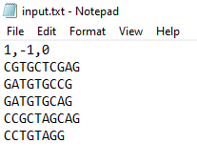
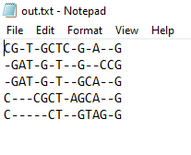
Results
INPUT
OUTPUT

Slide 13
Conclusions
An MSA can be observed as a representation that offers a unified picture of sequence similarity by averaging out matched residues that perhaps cannot be reliably matched over the entire lengths of the sequences.
This is because of evolution, mutations, insertions, and deletions of sequence fragments.
Given these difficulties, building a reliable MSA for a query set of sequences is an overwhelming task.
In this unit it has been made strong that the increased attention to multiple sequence alignment methodology has ensued in recent developments regarding most of its facets.

Slide 14
References
An algorithm of multiple sequence alignment based on consensus sequence searched by simulated annealing and star alignment.
https://ieeexplore.ieee.org/document/7344909
https://www.kaggle.com/thomasnelson/working-with-dna-sequencedata-for-ml

Slide 15
“Thank You For Your Attention”
- Gudipati Sai Krishna
- Nandi Dileep Kumar

